Slide 1
Why are mmp’s important to understand? How does Activa respond to the issue?
2018 AADR Poster Presentation

Slide 2
The MMP Story
Auto-degradation of collagen matrices occurs within hybrid layers created by contemporary dentin bonding systems, by the slow action of host-derived matrix metalloproteinases (MMPs).
It is concluded that all two-step etch-and-rinse and the one-step adhesives tested can activate endogenous MMP-2 and MMP-9 in human dentin. These results support the role of endogenous MMPs in the degradation of hybrid layers created by these adhesives. J Dent Res 92(1):82-86, 2013, j Dent Res. 2015 Feb; 94(2): 241–251.
So what does this mean to the clinician?
It simply means that regardless of adhesive and technique used, over time the layer between the dentin and the composite breaks down allowing for leakage and weakening of the interface.
No technique or product applied prior to the adhesive has shown to prevent this slow degradation of the collagen matrices.

Slide 3
Popular Adhesive and Enzymatic activity
In situ zymogramic views of dentin, hybrid, and adhesive layer showing the endogenous enzymatic activity. (A) Tridimensional model of the acquired image in the green channel of the multiphoton confocal microscope superposed on images obtained with differential interference contrast showing intense fluorescence, produced by gelatin hydrolysis and expression of MMP activity, throughout the entire extension of the hybrid layer created with Scotchbond 1 XT (3M ESPE).
J Dent Res. 2015 Feb; 94(2): 241–251.

Slide 4
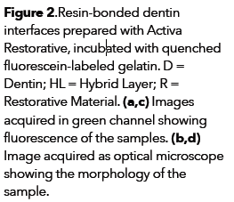
Activa and MMp’s at time 0

Slide 5
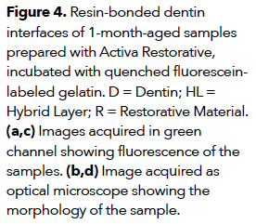
Activa and mmp’s at 1 month

Slide 6
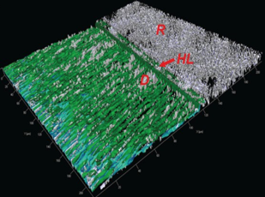
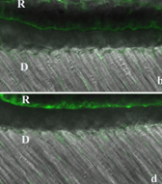
Conclusion: activa base/liner and activa restorative presented a low activity of dentinal endogenous proteases in the substrate at baseline, as well as after aging.

